Slide 1




University of Padua
Computer-ICT Engineering
Web Application
REMYTUTOR
Group members:
Dalla Mutta Marco
Dell’Anna Marco
Jin Xianwen
Memen Hamzah Obaid Salihi
Semencenco Victor
Ahmad Bashir Usman
10-06-2020
© RemyTutor: sharing knowledge and passions

Slide 2
University of Padua
Computer-ICT Engineering
Web Application
Outline
  1. Implementation and design choices: MySQL, html and css from scratch, use of jQuery to be full-compatible with AJAX - Victor
  Not storing the payment information (like credit cards) - Ahmad
  Chat part with AJAX (refreshing) and JSON for chats information - Memen
  3. Passwords with SHA2 (and pattern) and Quill.js - Jin
  2. Verification (certificate and identity) by checking the file existance - Victor
  (Not fully MVC)
  (Mainly WEB APP 1.0)
  Cookies – Marco P.
  Feedback system – Marco P.
  REST - Jin
10-06-2020
© RemyTutor: sharing knowledge and passions

Slide 3
University of Padua
Computer-ICT Engineering
Web Application
Introdcution
10-06-2020
© RemyTutor: sharing knowledge and passions

Slide 4
University of Padua
Computer-ICT Engineering
Web Application
What is RemyTutor?
RemyTutor is a remote learning platform for anything people might want to teach and transmit to others.
Main functionalities:
Searching the subjects of interest
Choosing the teacher based on their rating and price;
Managing personal profile
Asking/proposing the lessons with the chat included in the application
Rating a teacher after a lesson
Payment from the student to the teacher
10-06-2020
© RemyTutor: sharing knowledge and passions

Slide 5
University of Padua
Computer-ICT Engineering
Web Application
Design choices
Implementation of the web application from scratch without the use of any templates for the interface
Our web application is mainly 1.0 and the REST is implemented only for illustration purpose
Use of MySQL
Use of jQuery for AJAX calls to ensure cross-browser compatibility
Use of font-awesome library to add icons in a convenient form
10-06-2020
© RemyTutor: sharing knowledge and passions

Slide 6
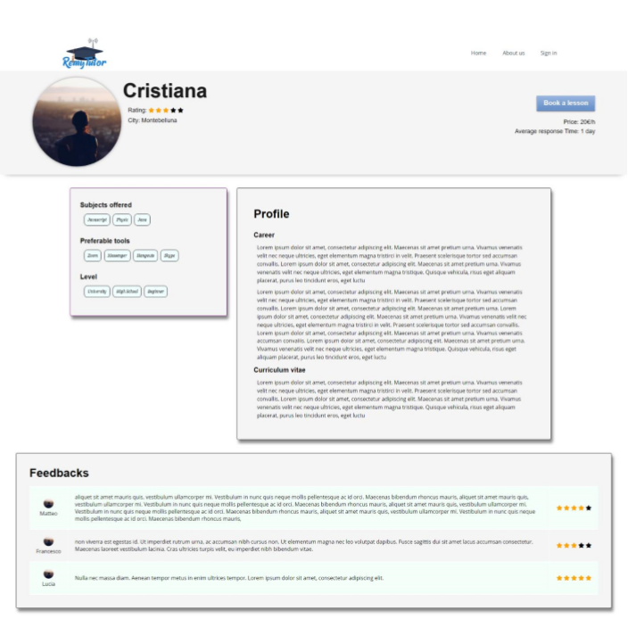
University of Padua
Computer-ICT Engineering
Web Application
Teacher page
10-06-2020
© RemyTutor: sharing knowledge and passions

Slide 7
University of Padua
Computer-ICT Engineering
Web Application
Verification and Identity check
All teachers have a verification status:
Identity check
Certification check
10-06-2020
© RemyTutor: sharing knowledge and passions

Slide 8
University of Padua
Computer-ICT Engineering
Web Application
Design choices
Implementation of the web application from scratch without the use of any templates for the interface
Our web application is mainly 1.0 and the REST is implemented only for illustration purpose
Use of MySQL
Use of jQuery for AJAX calls to ensure cross-browser compatibility
Use of font-awesome library to add icons in a convenient form
10-06-2020
© RemyTutor: sharing knowledge and passions

Slide 9
University of Padua
Computer-ICT Engineering
Web Application
Authentication
10-06-2020
© RemyTutor: sharing knowledge and passions

Slide 10
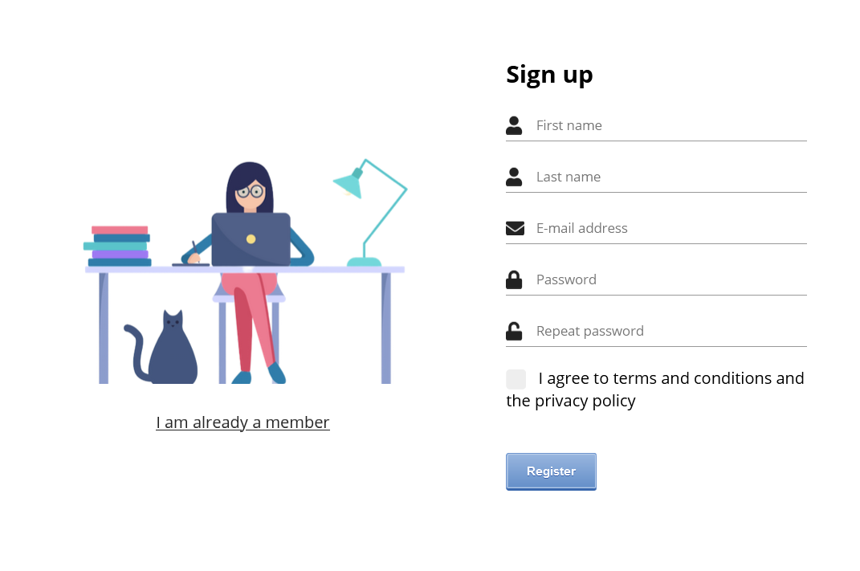
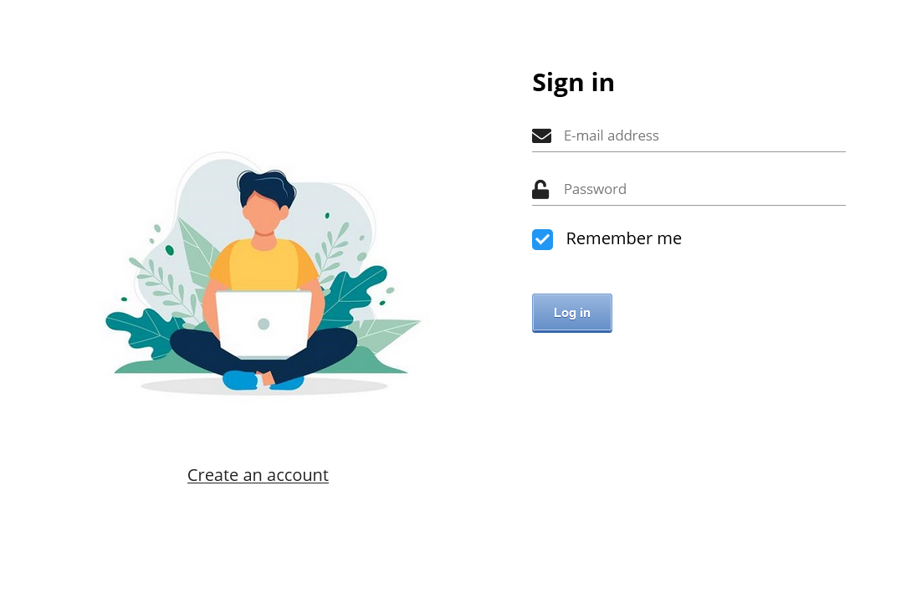
University of Padua
Computer-ICT Engineering
Web Application
For accessing our webapp's advanced features we require account creation through sign up/access thorugh sign in
10-06-2020
© RemyTutor: sharing knowledge and passions

Slide 11
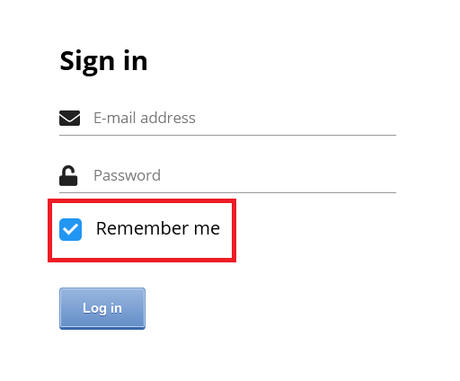
University of Padua
Computer-ICT Engineering
Web Application
Possibility to check a "Remember me" checkbox during sign in phase
Sets cookies, valid for 5 days
Every personal account page servlet checks for sign in session attribute or for the presence of these cookies
10-06-2020
© RemyTutor: sharing knowledge and passions

Slide 12
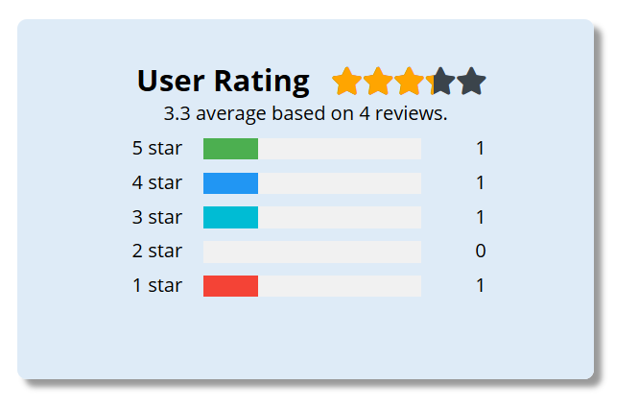
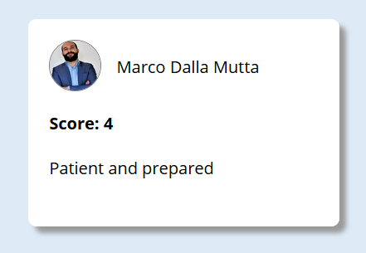
University of Padua
Computer-ICT Engineering
Web Application
Every student can give a feedback
to their teachers
These can be seen in the teacher page, but there's also a dedicated and detailed page in every user personal area
10-06-2020
© RemyTutor: sharing knowledge and passions

Slide 13
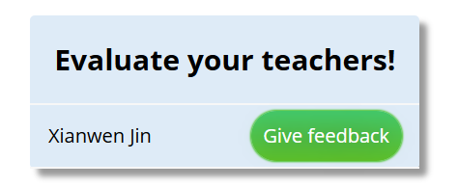
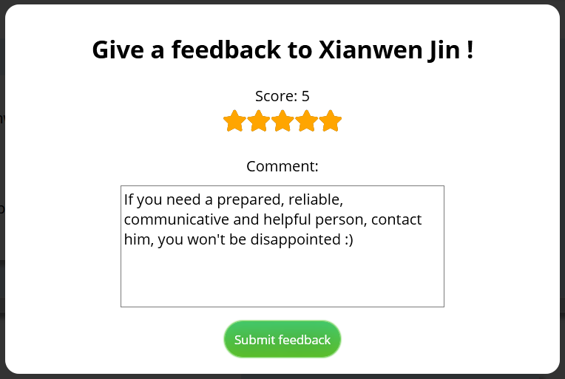
University of Padua
Computer-ICT Engineering
Web Application
In the same page resides the possibility to give a feedback
Score between 1 and 5 and, optionally, a comment
10-06-2020
© RemyTutor: sharing knowledge and passions

Slide 14
University of Padua
Computer-ICT Engineering
Web Application
Profile Page
10-06-2020
© RemyTutor: sharing knowledge and passions

Slide 15
University of Padua
Computer-ICT Engineering
Web Application
Password
  Pattern="(?=.*\d)(?=.*[a-z])(?=.*[A-Z]).{6,}" , which means that the password must contain at least 6 characters, including UPPER/lowercase and numbers;
  Cryptographic hash function SHA-256;
  Saved into database;
  Could be updated from personal profile page.
10-06-2020
© RemyTutor: sharing knowledge and passions

Slide 16
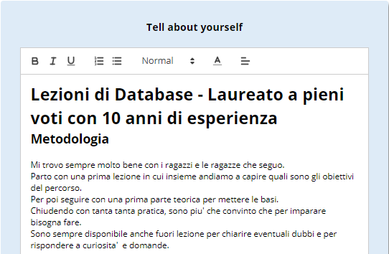
University of Padua
Computer-ICT Engineering
Web Application
Quill.js Editor
  Powerful Rich Text Editor;
  Its content is saved into database with html format.
10-06-2020
© RemyTutor: sharing knowledge and passions

Slide 17
University of Padua
Computer-ICT Engineering
Web Application
REST
Our web application is mainly 1.0 and the rest is implemented only for illustration purpose;
For simplicity, we implemented only readPerson() in PersonRestResource, but other methods such as updatePerson() could be developed easily by using updatePersonDAO.
10-06-2020
© RemyTutor: sharing knowledge and passions

Slide 18
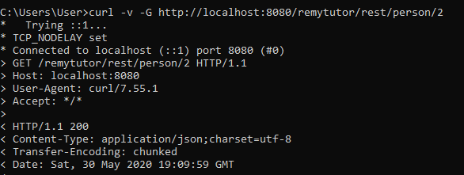
University of Padua
Computer-ICT Engineering
Web Application
REST
To read a person data, the request URI is: /person/{idUser}
10-06-2020
© RemyTutor: sharing knowledge and passions

Slide 19
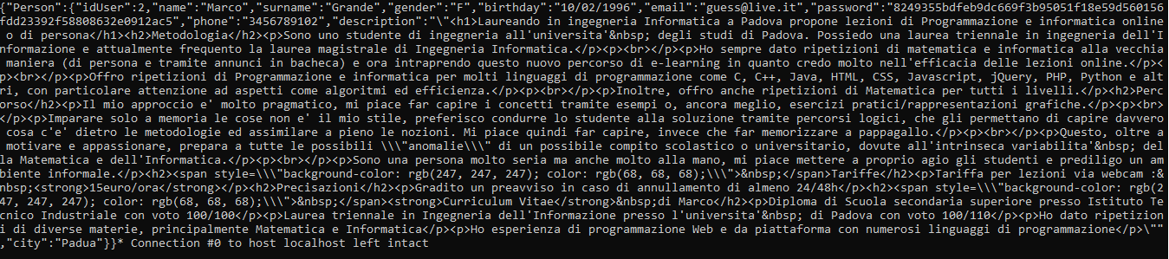
University of Padua
Computer-ICT Engineering
Web Application
REST
The result of the request.
10-06-2020
© RemyTutor: sharing knowledge and passions

Slide 20
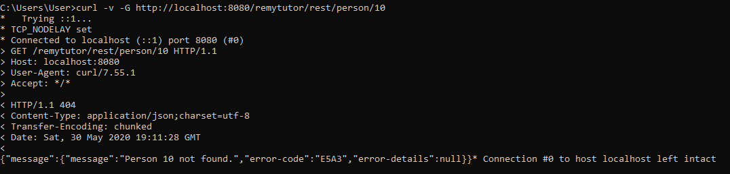
University of Padua
Computer-ICT Engineering
Web Application
REST
Querying a person that does not exist
10-06-2020
© RemyTutor: sharing knowledge and passions

Slide 21
University of Padua
Computer-ICT Engineering
Web Application
Chat Page
10-06-2020
© RemyTutor: sharing knowledge and passions

Slide 22
University of Padua
Computer-ICT Engineering
Web Application
10-06-2020
10-06-2020
© RemyTutor: sharing knowledge and passions
© RemyTutor: sharing knowledge and passions

Slide 23
University of Padua
Computer-ICT Engineering
Web Application
Chat
Users are peers but once the request is issued, the roles are well defined.
Lesson proposal mechanism (teacher student).
Student can reject the proposal or accept it in which case payments (next slide)
10-06-2020
© RemyTutor: sharing knowledge and passions

Slide 24
University of Padua
Computer-ICT Engineering
Web Application
Payment Page
10-06-2020
10-06-2020
© RemyTutor: sharing knowledge and passions
© RemyTutor: sharing knowledge and passions

Slide 25
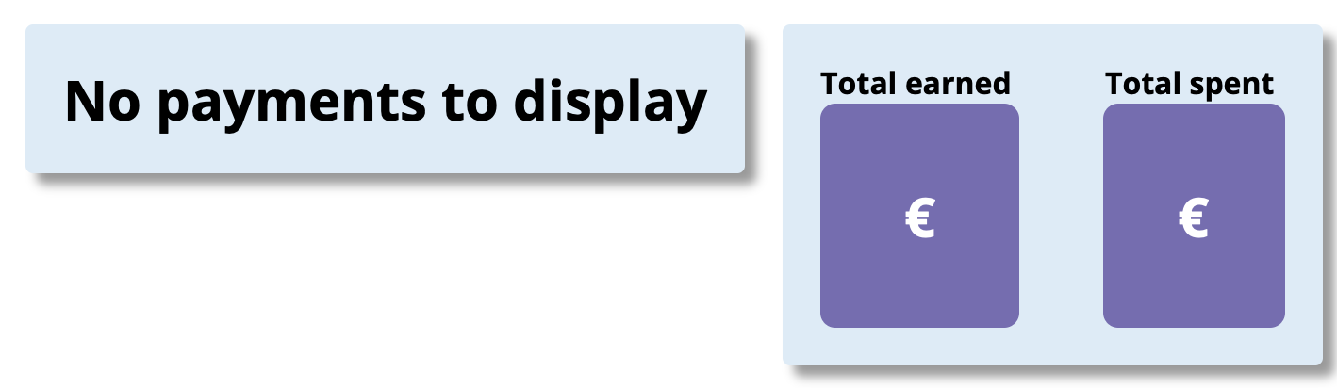
University of Padua
Computer-ICT Engineering
Web Application
Payments page
Payments page display all the transaction made for the courses delivered successfully to the student.
The transaction might be incoming /outgoing, calculated as a total earned and total spent respectively for each user since the account creation.
.
10-06-2020
10-06-2020
© RemyTutor: sharing knowledge and passions
© RemyTutor: sharing knowledge and passions

Slide 26
University of Padua
Computer-ICT Engineering
Web Application
Payments page
We did not subscribe to a real online payment system.
  Expensive in terms of deployment.
We do no store payment information except for amount, date/time
10-06-2020
10-06-2020
© RemyTutor: sharing knowledge and passions
© RemyTutor: sharing knowledge and passions

Slide 27
Thanks for your attention!

